Slide 1
Rates
Week 5 Lesson 1

Slide 2
Recap
So far we have looked at rates a measure of two variables in relation to each other.
We have established that we use rates in everyday life
We have also seen how we can apply rates to our personal selves in heart rates, measured as BPM.
Lastly, we learned how to convert rates to singular units using the unitary method.

Slide 3
Topic: Base Metabolic Rate (BMR)
Metabolism is the way in which our body processes kilojoules (the energy we receive from food.)
The Base Metabolic rate is the bare minimum amount of Kilojoules that your body needs to meet its requirements.
You also have a PAL- your physical activity level. BMR is needed to meet the damandes of your PAL and basic bodily functions. So how do we find out what our base input should be?
EQ: What is BMR, and how does it help us in relation to our PAL?

Slide 4
How to find your BMR
Like most things in real life, we can use a formula to help us find out what our BMR should be.
The initial formula derived in the early 1930’s has now been refined in the 1990’s to be read as
Men | BMR = (10 × weight in kg) + (6.25 × height in cm) - (5 × age in years) + 5
Women | BMR = (10 × weight in kg) + (6.25 × height in cm) - (5 × age in years) - 161
Note, the output is in calories- so we need to multiply the value by 4.2 to obtain a Kj rating

Slide 5
BMR and PAL
We need to establish a persons PAL (Physical Activity Level) , to determine there TEE (Total Energy Expenditure)
PAL is a modifier assigned to the intensity of our actions- sleeping has a modifier of 1, sitting has a modifier of 1.5, swimming is 2.5 ect, that we then multiply our BMR by.
Some examples are listed below:
Lifestyle | Example | PAL | Calculation
Sedentary or light activity | Office worker getting little or no exercise | 1.53 | BMR x 1.53
Active or moderately active | Construction worker or person running one hour daily | 1.76 | BMR x 1.76
Vigorously active | Agricultural worker (non mechanized) or person swimming two hours daily | 2.25 | BMR x 2.25

Slide 6
Worked Example:
John is 35 years old a fit runner, who runs an hour each day. He is 70kg and 180cm tall. What is his BMR, then his TEE?
BMR = (10 × weight in kg) + (6.25 × height in cm) - (5 × age in years) + 5
BMR= (10 x 75)+(6.25 x 180) – (5 x 35) + 5
BMR = 1700.
BMR as KJ= 1700x4.2 = 7,140kj per day.
7140 BMR / 24 = 297.5 kj per hour.
His TEE: one hour BMR(Kj) x 1.76 = 523.6kj for his one hour of running
Total Kj = 297.5 x 23 hours of sedidentary work + 523.6 for the hour of running = 7366.1Kj per day.

Slide 7
We do
Nina is a 19 year old karate master, who does 3 hours of intense training daily. She is 65kg and 170cm tall.
Calculate her BMR: BMR = (10 × weight in kg) + (6.25 × height in cm) - (5 × age in years) – 161
Karate has a PAL modifier of 4.5.
What is Nina’s TEE:

Slide 8
Answers
Nina is a 19 year old karate master, who does 3 hours of intense training daily. She is 65kg and 170cm tall.
BMR = (10 ×65) + (6.25 × 170) - (5 × 19) – 161
=1646.5cal x 4.2
= 6915.3Kj per day.
6915.3/24 = 288.1375 Kj per hour.
Total karate hours = 3 x 288.1375 = 864.4125 Kj for three hours
PAL = 4.5 x 864.4125 = ~3889.86 Kj for Karate
21 x 288.1375 = 6050.89Kj + 3889.86 kj = 9940.75 Kj for TEE.

Slide 9
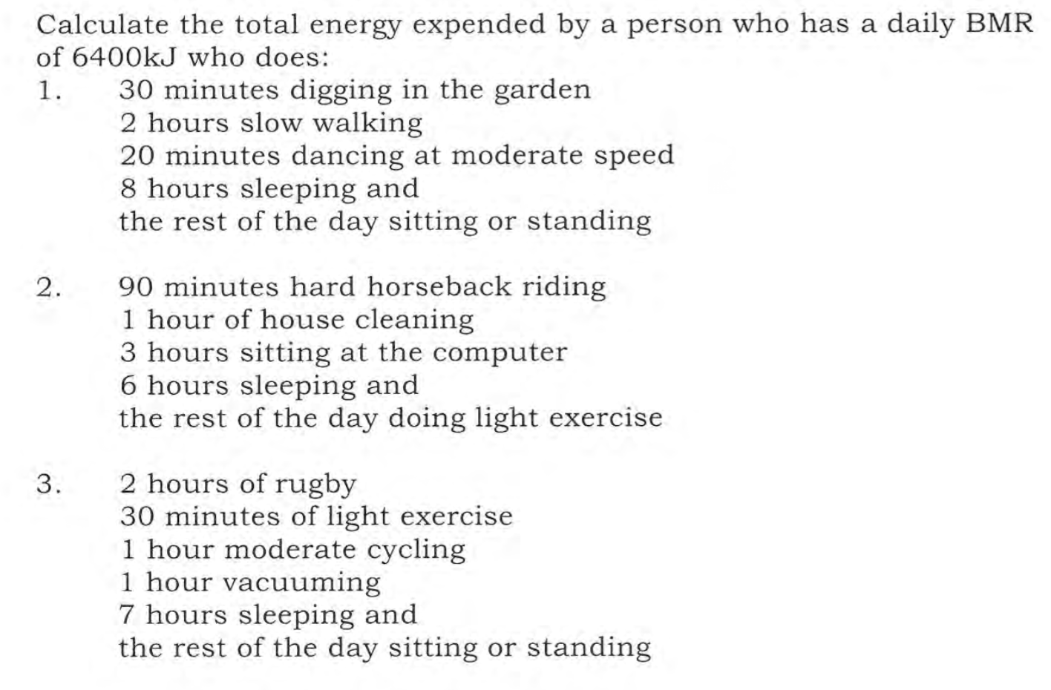
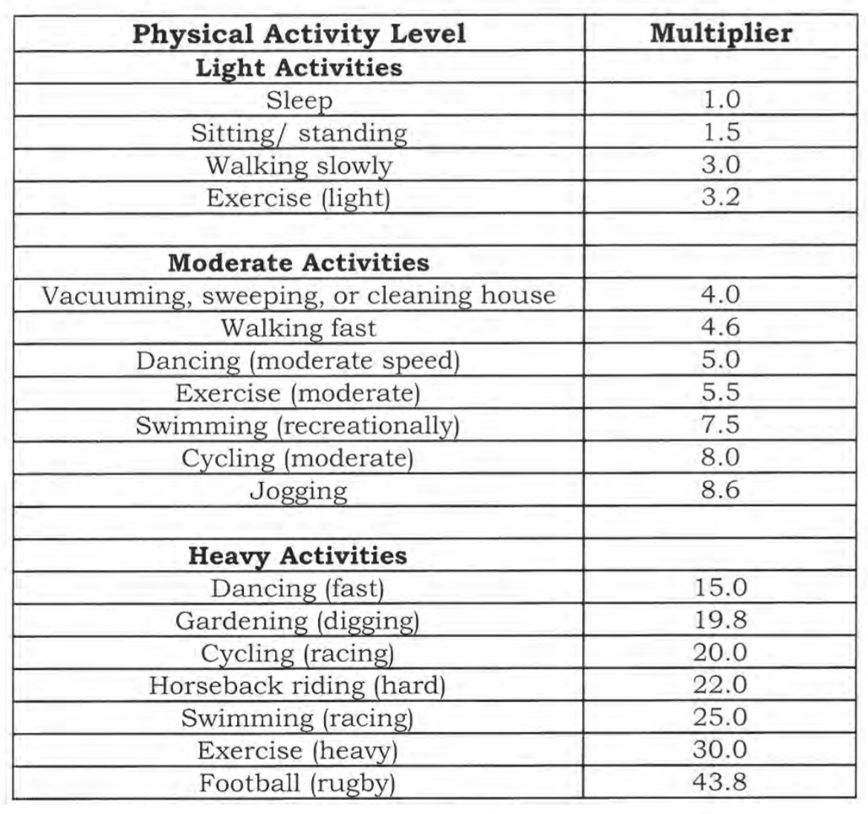
You do: BMR x TEE
To find total daily expenditure using

